Slide 2

BANK LOAN ANALYSIS REPORT OVERVIEW
Presented by Group 3 :
1. Sohil Nadaf
2. Arth Singh
3. Supriya Narkhedkar
4. Pradeep kumar Painuli
5. Sunhera Begum
6. Amit Prakash Manchekar
7. Chekka Akhil Kumar
Data Analyst Internship at ExcelR Solutions

Slide 3

Agenda
Introduction
KPIs(Key Performance Indicators)
Visualization Dashboard Overview
SQL Queries with Output
Challenges Faced
Data-Driven Decision Making
Solution and Suggestions
Conclusion
BANK LOAN ANALYSIS

Slide 4
Introduction to
Bank loan analysis
Objective: To analyze bank loan data to uncover key trends, insights, and patterns in lending and repayments.
Scope: This analysis covers various aspects of loan data, including year-wise loan amounts, payment verification status, risk assessment by grade, state-wise loan activity, and loan purposes.
Purpose: To provide data-driven insights that can help improve lending strategies, reduce risk, and identify opportunities for increasing loan approvals and repayments.
Data Source: The data used in this analysis is obtained from Finance_1 and Finance_2 Datasets with over 39k+ records.

Slide 5
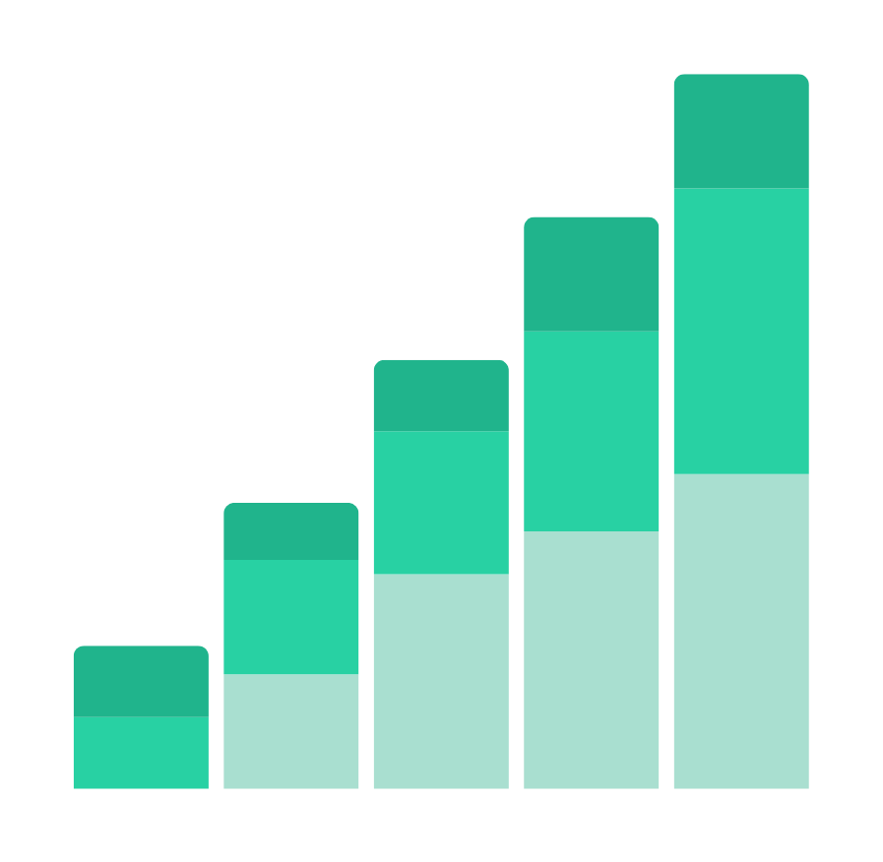
Key Performance Indicators
1. Year wise loan amount Stats.
2. Grade and sub grade wise revolving balance.
3. Total Payment for Verified Status Vs
Total Payment for Non Verified Status.
4. State wise and month wise loan status.
5. Home ownership Vs last payment date stats.

Slide 6
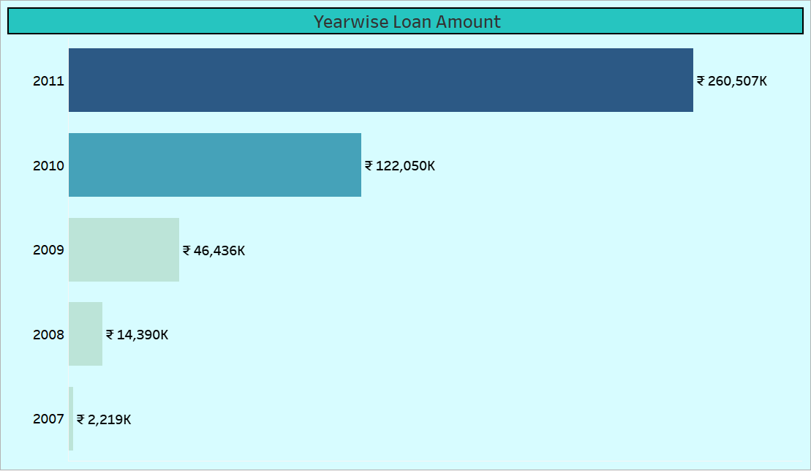
KPI I – Year wise Loan Amount Status
The data shows a significant increase in loan amounts over the years. From a lowest $2.22 million in 2007, the loan amounts has increased to $260.50 million by 2011. This upward trend suggests growing lending activity and increased borrowing, likely due to economic factors and expanded lending criteria during this period."

Slide 7
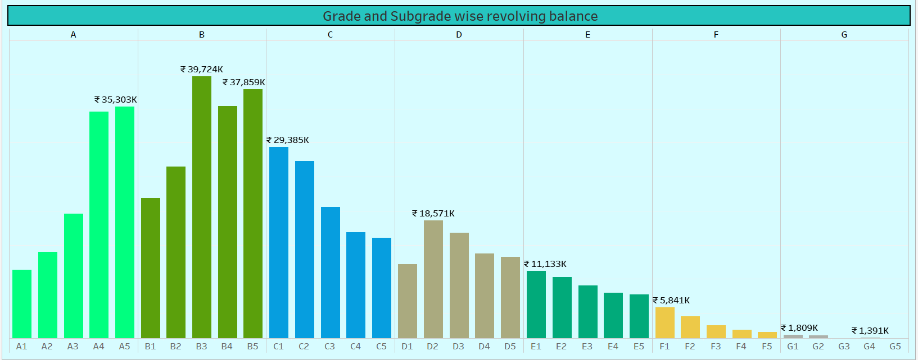
KPI II – Grade and Subgrade wise Revolving Balance
The revolving balance varies significantly across different grades. Grade A has the lowest balance, suggesting strong repayment behaviour. Conversely, Grade G has the highest balance, which could indicate higher risk associated with these loans. Within each grade, subgrades also show varying balances, which may provide insight into specific credit quality within broader categories."

Slide 8
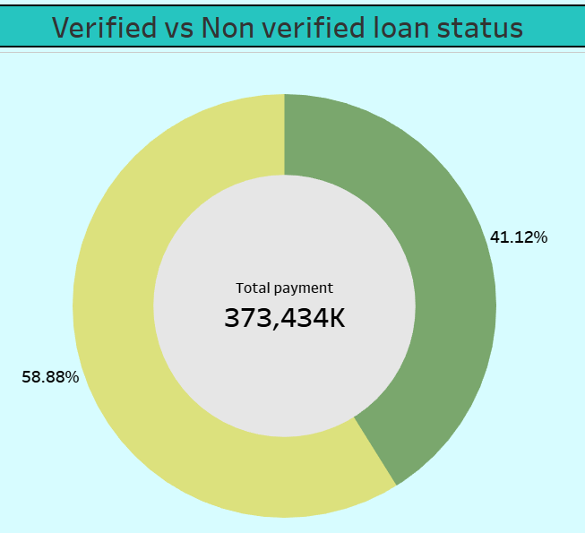
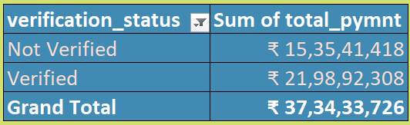
KPI III – Total Payment for Verified Status Vs Total Payment for
Non Verified Status
Non-Verified
Verified
"Verified payments total $219.89 million, which is substantially higher than the $153.54 million from non-verified sources. This indicates that the majority of the total payments are from verified loans, reflecting a more reliable source of payment. The larger amount in verified payments highlights the importance of maintaining thorough verification processes so that we can convert non verified to verified payment."

Slide 9
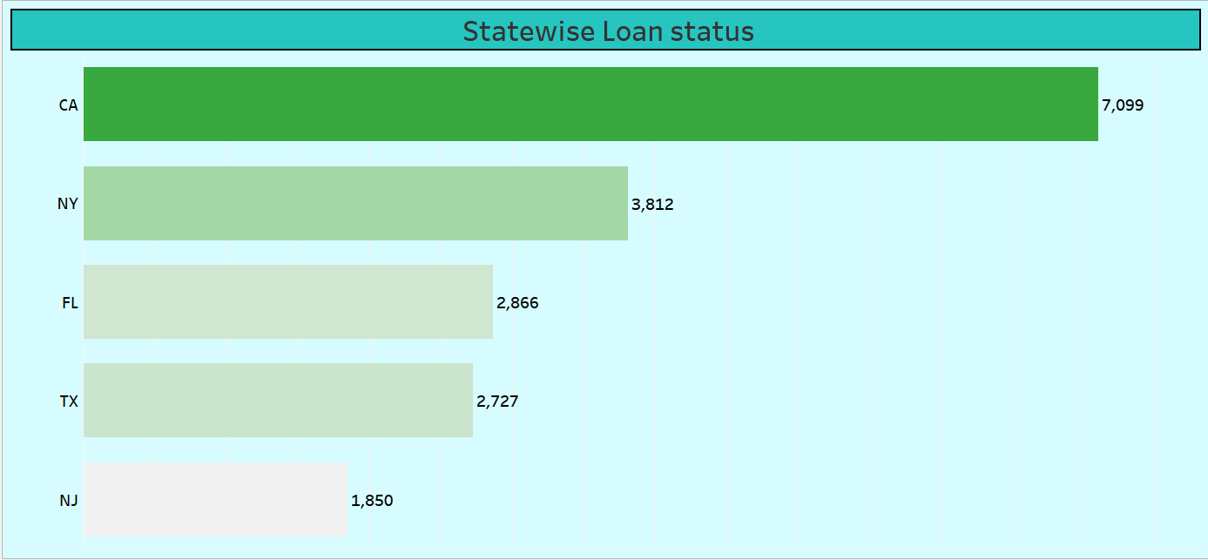
KPI IV – State wise Loan Status
California, New York, and Florida have the highest number of loans, reflecting high borrowing activity in these states. States with fewer loans, such as Maine and Montana, show lower borrowing rates, which may be due to smaller population sizes or different economic conditions."

Slide 10
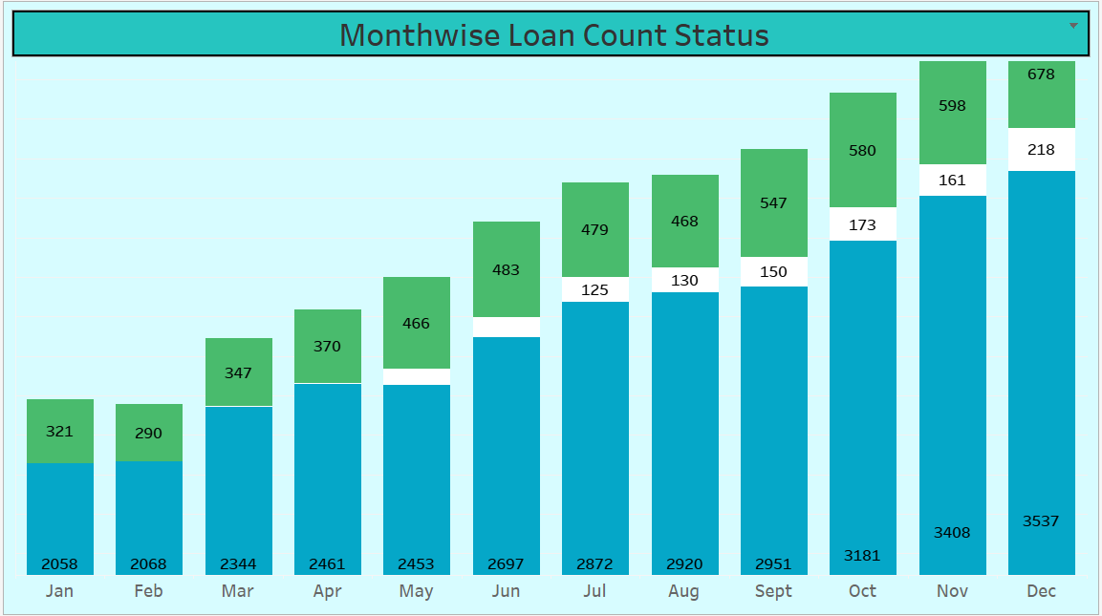
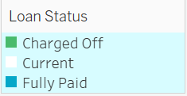
KPI V – Month wise Loan Status
• Highest in May: 4,285 loans
• Lowest in June: 2,933 loans
Loan applications peak in May, indicating a potential seasonal trend or an increase in borrowing activity during this period. Conversely, June shows the lowest number of loans, which may be due to seasonal factors or other influences affecting loan application rates.

Slide 11
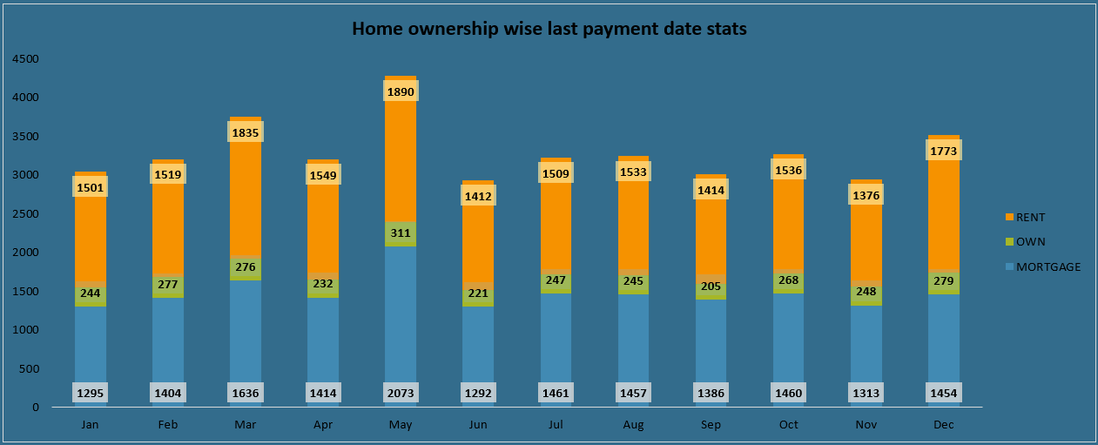
KPI VI – Home ownership Vs last payment date stats
• Highest Payments in May: 4,285
• Lowest in June: 2,933
"Homeowners typically make payments more regularly, with significant activity noted in May. The trend suggests that home ownership might influence payment timing, with fewer payments recorded in June, potentially due to various factors such as financial planning or seasonal variations."

Slide 12
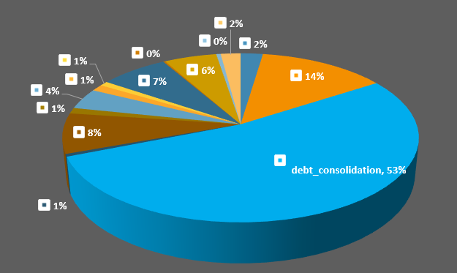
KPI VI – Loan Amount vs Purpose Stats
The largest portion of loans is for debt consolidation, indicating that many borrowers are focusing on managing and consolidating existing debts. Credit card loans and home improvement loans follow, showing common reasons for borrowing. Smaller segments for purposes like medical or educational expenses suggest less frequent but still significant needs

Slide 13

Visualizing Bank Loan Data: Dashboard Showcase

Slide 14
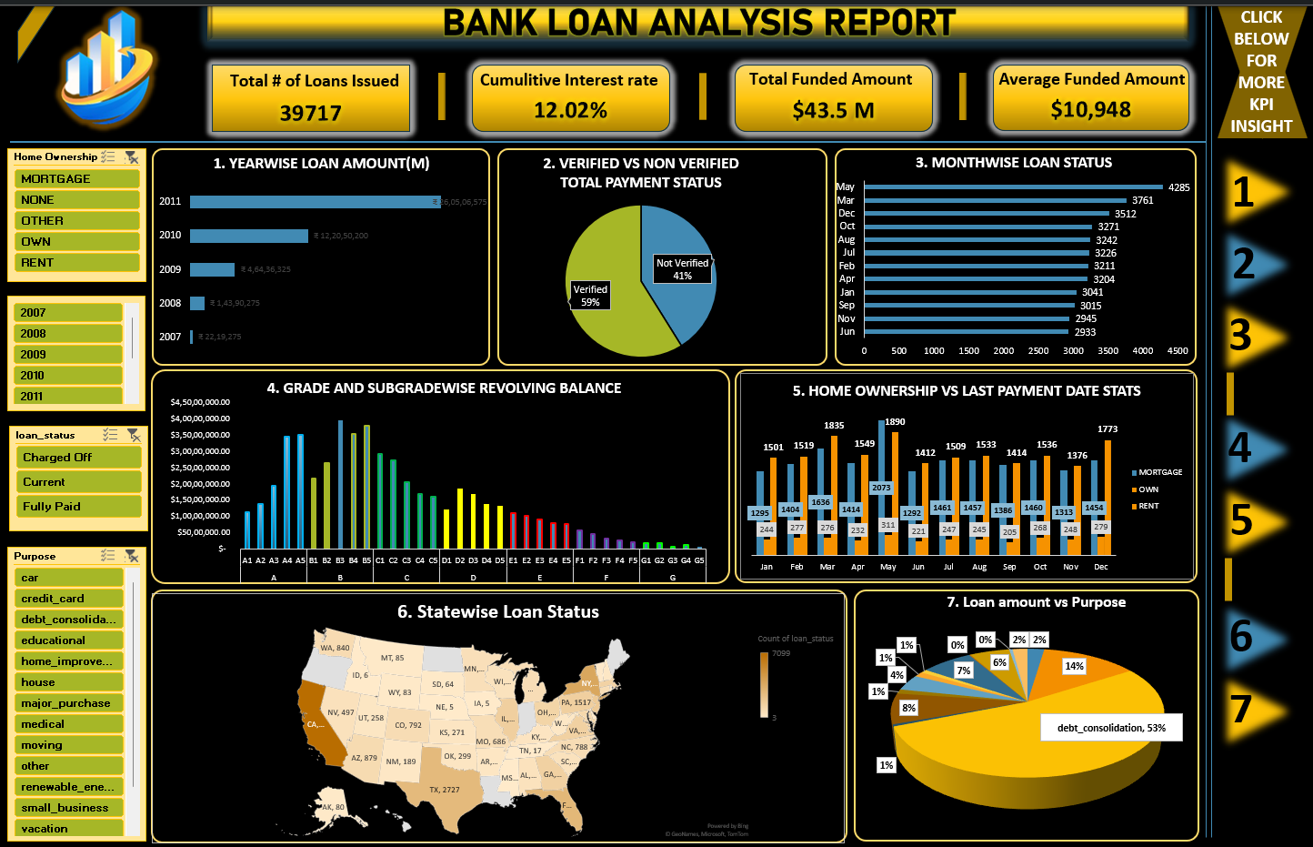
E
X
C
E
L
D
A
S
H
B
O
A
R
D

Slide 15
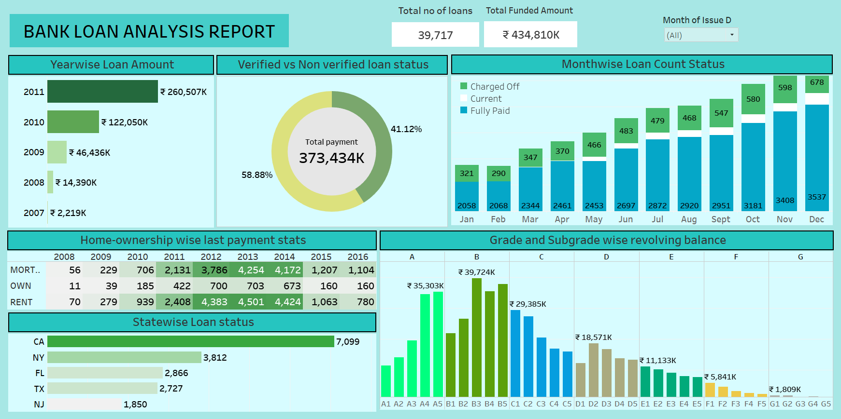
Tableau Dashboard

Slide 16
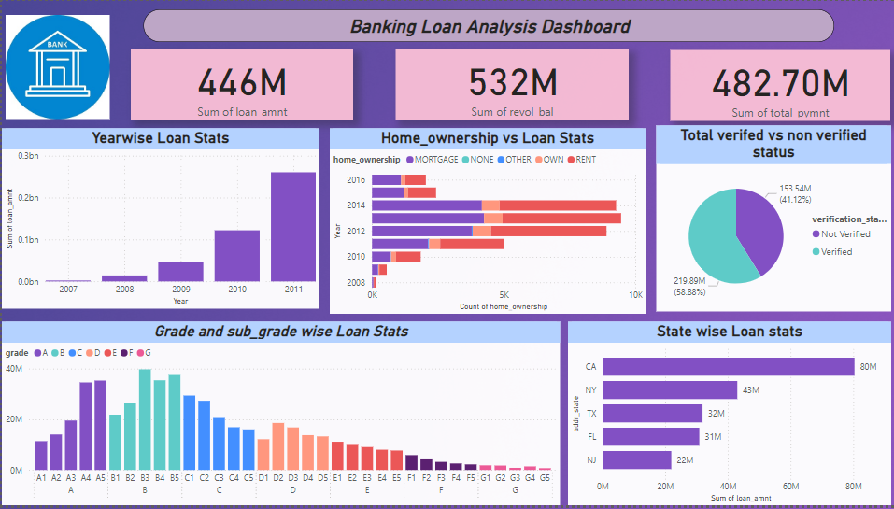
Power BI Dashboard

Slide 17

Queries. .

Slide 18
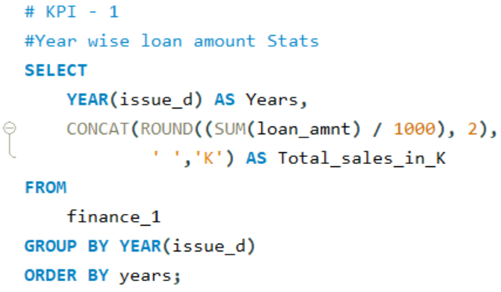
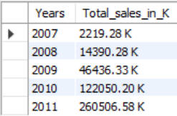
KPI I – Year wise Loan Amount Status
Query
Output

Slide 19
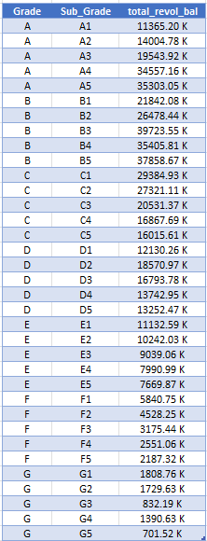
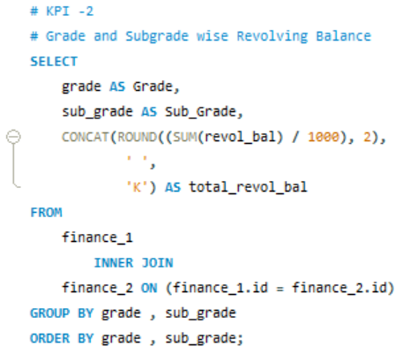
KPI II – Grade and Subgrade wise Revolving Balance
Query
Output

Slide 20
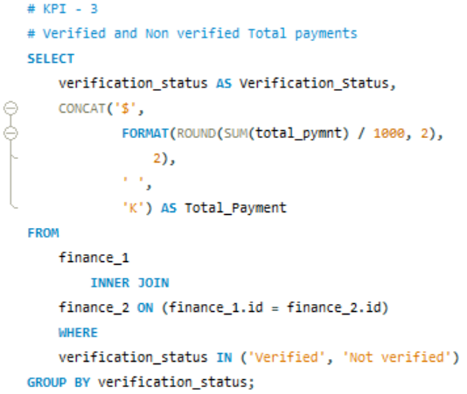
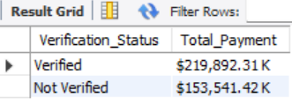
KPI III – Total Payment for Verified Status Vs Total Payment for
Non Verified Status
Query
Output

Slide 21
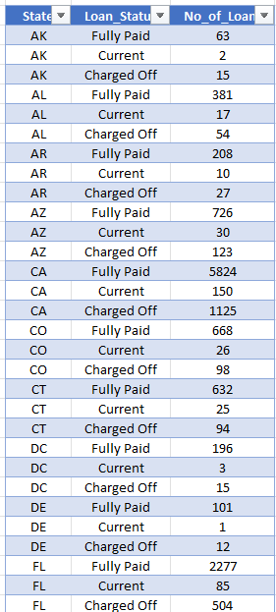
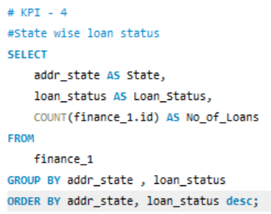
KPI IV – State wise Loan Status
Query
Output

Slide 22
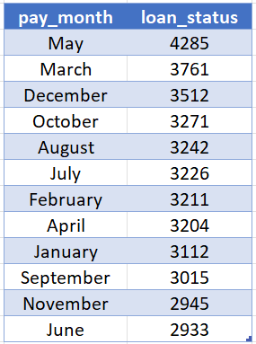
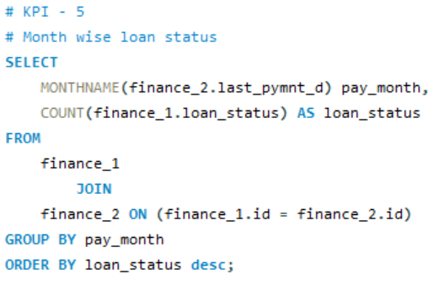
KPI V – Month wise Loan Status
Query
Output

Slide 23
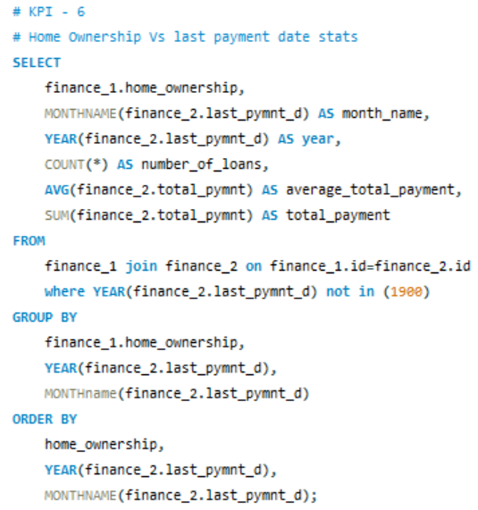
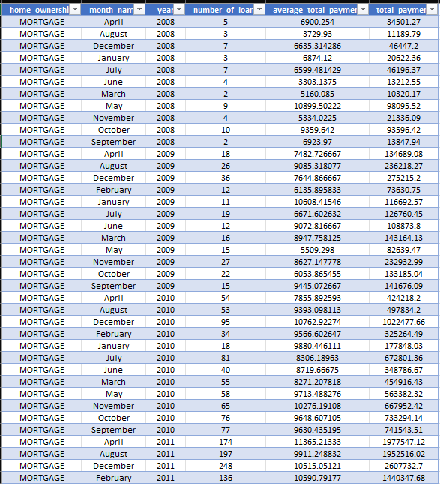
KPI VI – Home ownership Vs last payment date stats
Query
Output

Slide 24
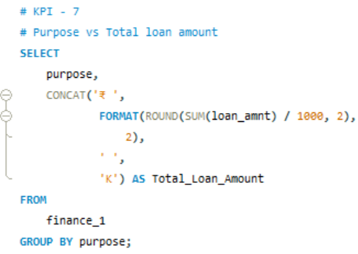
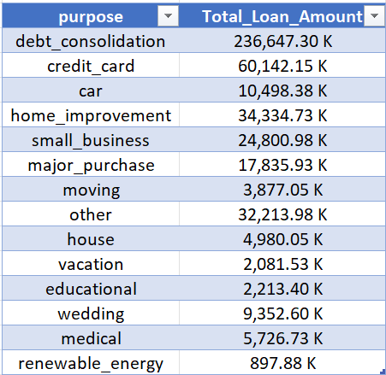
KPI VII – Loan Amount vs Purpose Stats
Query
Output

Slide 25

Challenges faced
1. Data Quality Issues
Problems with checking if loan data is correct.
Hard to keep all records accurate and complete.
2. Seasonality Effects
Loan applications and payments change from month to month.
Need to consider seasonal patterns that could affect the analysis.
3. Risk Assessment
Difficult to sort and evaluate the risk for different loan types.
Managing high-risk borrowers who have larger unpaid balances.
4. State Disparities
Borrowing rates differ from state to state.
Economic and population differences impact loan demand.

Slide 26

Data-Driven Decision Making
Prioritize Verified Loans
Focus on verified loans in future lending decisions.
Enhance verification processes to increase the pool of reliable borrowers.
Adjust Lending Criteria
Modify criteria based on insights from grade and subgrade analysis.
Develop targeted loan products to cater to different risk profiles.
Seasonal Promotions
Capitalize on peak borrowing periods like May with special loan offers.
Introduce incentives during slower months, such as June, to stimulate demand.
Target High-Borrowing States
Direct marketing efforts towards states like California, New York, and Florida.
Develop state-specific strategies to maximize lending opportunities.

Slide 27
Solution and Suggestions
Enhanced Verification Processes
Implement stricter verification protocols to ensure data accuracy.
Focus on converting non-verified loans to verified status for better repayment reliability.
Seasonal Adjustments
Develop analytical models that adjust for seasonal trends.
Offer tailored loan products to match seasonal borrowing patterns.
Risk-Based Lending Strategies
Adjust lending criteria based on grade and subgrade analysis.
Introduce risk-based pricing to manage high-risk loans more effectively.
State-Specific Lending Programs
Create targeted lending strategies for states with different economic conditions.
Customize loan products to meet the specific needs of borrowers in high-demand states.

Slide 28
Conclusion
1. Enhanced Verification Processes
Implement stricter verification protocols to ensure data accuracy.
Focus on converting non-verified loans to verified status for better repayment reliability.
2. Seasonal Adjustments
Develop analytical models that adjust for seasonal trends.
Offer tailored loan products to match seasonal borrowing patterns.
3. Risk-Based Lending Strategies
Adjust lending criteria based on grade and subgrade analysis.
Introduce risk-based pricing to manage high-risk loans more effectively.
4. State-Specific Lending Programs
Create targeted lending strategies for states with different economic conditions.
Customize loan products to meet the specific needs of borrowers in high-demand states.

Slide 29


Thank you very much!

